Slide 1
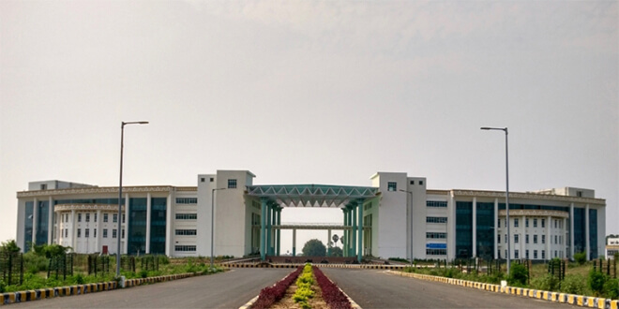

Introduction to Cloud Computing
Dr. Rajiv Misra
Associate Professor
Dept. of Computer Science & Engg.
Indian Institute of Technology Patna
rajivm@iitp.ac.in
Cloud Computing and Distributed Systems
Introduction to Cloud Computing

Slide 2
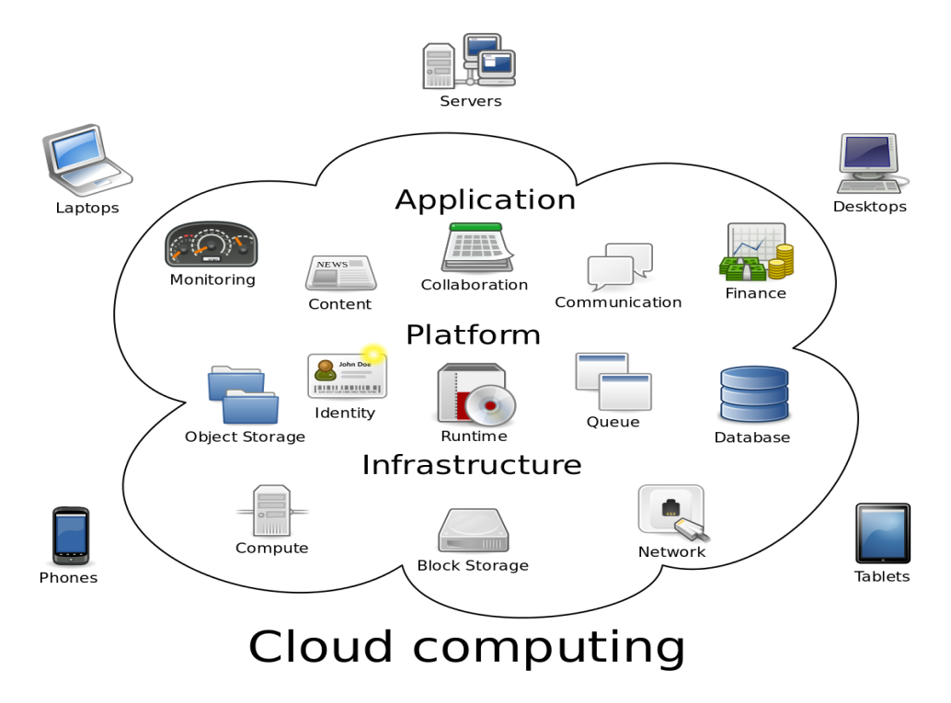
Preface
Content of this Lecture:
In this lecture, we will discuss a brief introduction to Cloud Computing and also focus on the aspects i.e. Why Clouds, What is a Cloud, Whats new in todays Clouds and also distinguish Cloud Computing from the previous generation of distributed systems.
Cloud Computing and Distributed Systems
Introduction to Cloud Computing

Slide 3
Scalable Computing Over the Internet
Evolutionary changes that have occurred in distributed and cloud computing over the past 30 years, driven by applications with variable workloads and large data sets .
Evolutionary changes in machine architecture, operating system platform, network connectivity, and application workload.
Distributed computing system uses multiple computers to solve large-scale problems over the Internet. Thus, distributed computing becomes data-intensive and network-centric.
The emergence of computing clouds instead demands high-throughput computing (HTC) systems built with distributed computing technologies.
High-throughput computing (HTC) appearing as computer clusters, service-oriented architecture, computational grids, peer-to-peer networks, Internet clouds, and the future Internet of Things.
Cloud Computing and Distributed Systems
Introduction to Cloud Computing

Slide 4
The Hype of Cloud: Forecasting
Gartner in 2009 – Cloud computing revenue will soar faster than expected and will exceed $150 billion by 2013. It will represent 19% of IT spending by 2015.
IDC in 2009: “Spending on IT cloud services will triple in the next 5 years, reaching $42 billion.”
Forrester in 2010 – Cloud computing will go from $40.7 billion in 2010 to $241 billion in 2020.
Companies and even federal/state governments using cloud computing now: fbo.gov
Cloud Computing and Distributed Systems
Introduction to Cloud Computing

Slide 5


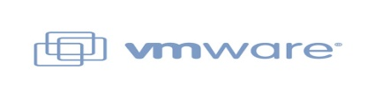
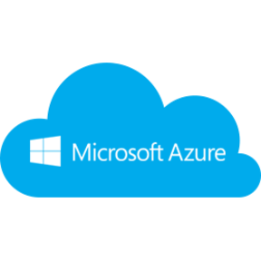
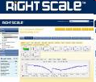
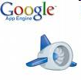
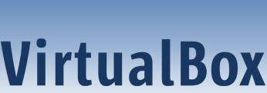
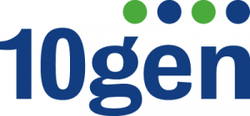

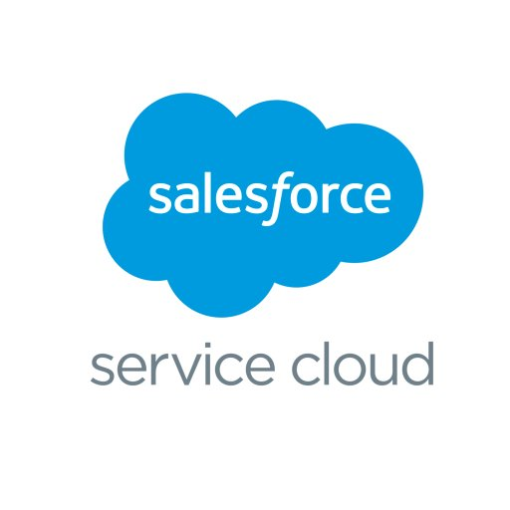
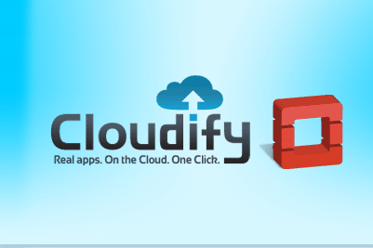
Many Cloud Providers
AWS: Amazon Web Services
EC2: Elastic Compute Cloud
S3: Simple Storage Service
EBS: Elastic Block Storage
Microsoft Azure
Google Compute Engine/AppEngine
Rightscale, Salesforce, EMC, Gigaspaces, 10gen, Datastax, Oracle, VMWare, Yahoo, Cloudera
And 100s more…
Cloud Computing and Distributed Systems
Introduction to Cloud Computing

Slide 6
Categories of Clouds
Can be either a (i) public cloud, or (ii) private cloud
Private clouds are accessible only to company employees
Public clouds provide service to any paying customer:
Amazon S3 (Simple Storage Service): store arbitrary datasets, pay per GB-month stored
Amazon EC2 (Elastic Compute Cloud): upload and run arbitrary OS images, pay per CPU hour used
Google App Engine/Compute Engine: develop applications within their App Engine framework, upload data that will be imported into their format, and run
Cloud Computing and Distributed Systems
Introduction to Cloud Computing

Slide 7
Customers Save: Time and Money
“With AWS, a new server can be up and running in three minutes compared to seven and a half weeks to deploy a server internally and a 64-node Linux cluster can be online in five minutes (compared with three months internally.”
“With Online Services, reduce the IT operational costs by roughly 30% of spending”
“A private cloud of virtual servers inside its datacenter has saved nearly crores of rupees annually, because the company can share computing power and storage resources across servers.”
100s of startups can harness large computing resources without buying their own machines.
Cloud Computing and Distributed Systems
Introduction to Cloud Computing

Slide 8
What is a Cloud?
Advances in virtualization make it possible to see the growth of Internet clouds as a new computing paradigm.
i.e. dramatic differences between developing software for millions to use as a service versus distributing software to run on their PCs.”
History:
In 1984, John Gage Sun Microsystems gave the slogan, “The network is the computer.”
In 2008, David Patterson UC Berkeley said, “The data center is the computer.”
Recently, Rajkumar Buyya of Melbourne University simply said: “The cloud is the computer.”
Some people view clouds as grids or clusters with changes through virtualization, since clouds are anticipated to process huge data sets generated by the traditional Internet, social networks, and the future IoT.
Cloud Computing and Distributed Systems
Introduction to Cloud Computing

Slide 9
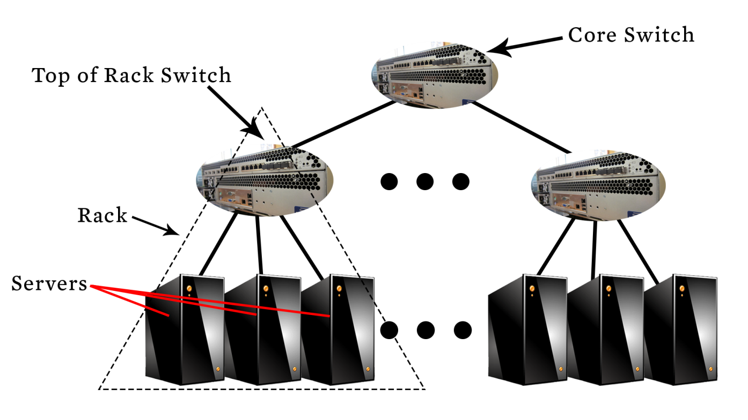
What is a Cloud?
A single-site cloud (as known as “Datacenter”) consists of
Compute nodes (grouped into racks)
Switches, connecting the racks
A network topology, e.g., hierarchical
Storage (backend) nodes connected to the network
Front-end for submitting jobs and receiving client requests
(Often called “three-tier architecture”)
Software Services
A geographically distributed cloud consists of
Multiple such sites
Each site perhaps with a different structure and services
Cloud Computing and Distributed Systems
Introduction to Cloud Computing

Slide 10
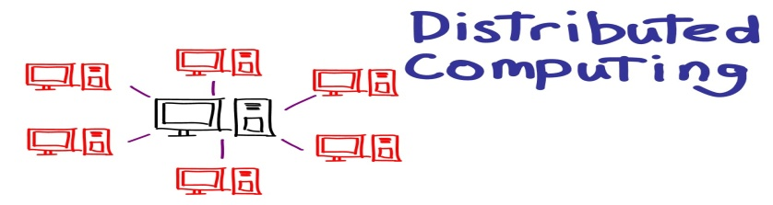
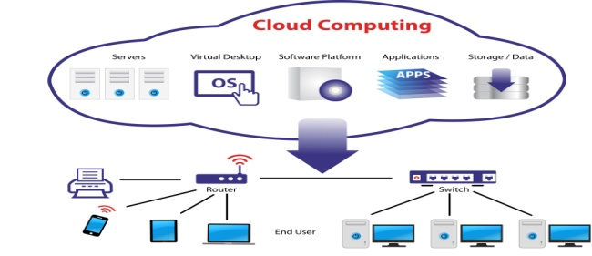
Computing Paradigm Distinctions
Cloud computing overlaps with distributed computing.
Distributed computing: A distributed system consists of multiple autonomous computers, having its own memory, communicating through message passing.
Cloud computing: Clouds can be built with physical or virtualized resources over large data centers that are distributed systems. Cloud computing is also considered to be a form of utility computing or service computing.
Cloud Computing and Distributed Systems
Introduction to Cloud Computing

Slide 11
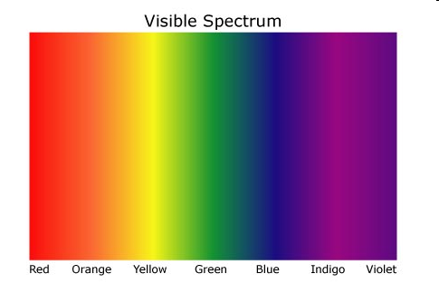
“A Cloudy History of Time”
The first datacenters!
Timesharing Companies
& Data Processing Industry
Clouds and datacenters
1940
1950
Clusters
1960
Grids
1970
1980
PCs
(not distributed!)
1990
2000
Peer to peer systems
2012
Cloud Computing and Distributed Systems
Introduction to Cloud Computing

Slide 12
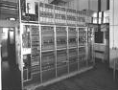

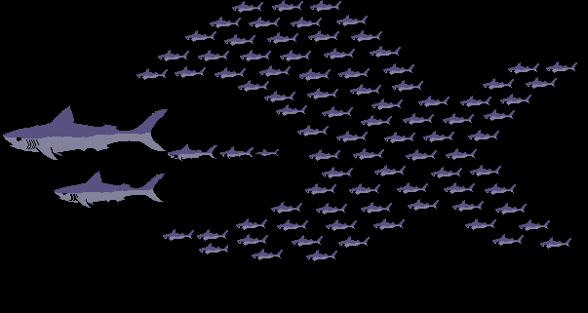
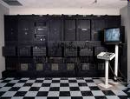




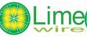
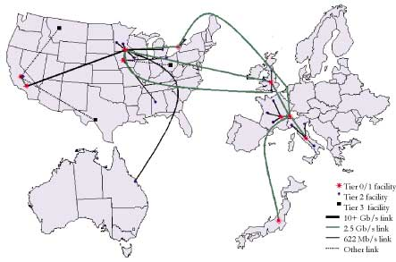

“A Cloudy History of Time”
First large datacenters: ENIAC, ORDVAC, ILLIAC
Many used vacuum tubes and mechanical relays
Berkeley NOW Project
Supercomputers
Server Farms (e.g., Oceano)
1940
1950
1960
P2P Systems (90s-00s)
Many Millions of users
Many GB per day
1970
1980
Data Processing Industry
- 1968: $70 M. 1978: $3.15 Billion
1990
Timesharing Industry (1975):
Market Share: Honeywell 34%, IBM 15%,
Xerox 10%, CDC 10%, DEC 10%, UNIVAC 10%
Honeywell 6000 & 635, IBM 370/168,
Xerox 940 & Sigma 9, DEC PDP-10, UNIVAC 1108
2000
2012
Clouds
Grids (1980s-2000s):
GriPhyN (1970s-80s)
Open Science Grid and Lambda Rail (2000s)
Globus & other standards (1990s-2000s)
Cloud Computing and Distributed Systems
Introduction to Cloud Computing

Slide 13
Scalable Computing Trends: Technology
Doubling Periods – storage: 12 months, bandwidth: 9 months, and CPU compute capacity: 18 months (what law is this?)
Moore’s law indicates that processor speed doubles every 18 months.
Gilder’s law indicates that network bandwidth has doubled each year in the past.
Then and Now
Bandwidth
1985: mostly 56Kbps links nationwide
2015: Tbps links widespread
Disk capacity
Today’s PCs have TBs, far more than a 1990 supercomputer
Cloud Computing and Distributed Systems
Introduction to Cloud Computing

Slide 14
The Trend toward Utility Computing
Aiming towards autonomic operations that can be self-organized to support dynamic discovery. Major computing paradigms are composable with QoS and SLAs (service-level agreements).
In 1965, MIT's Fernando Corbató of the Multics operating system envisioned a computer facility operating “like a power company or water company”.
Plug your thin client into the computing Utility and Play Intensive Compute & Communicate Application
Utility computing focuses on a business model in which customers receive computing resources from a paid service provider.
All grid/cloud platforms are regarded as utility service providers.
Cloud Computing and Distributed Systems
Introduction to Cloud Computing

Slide 15
Features of Today’s Clouds
Massive scale: Very large data centers, contain tens of thousands sometimes hundreds of thousands of servers and you can run your computation across as many servers as you want and as many servers as your application will scale.
On-demand access: Pay-as-you-go, no upfront commitment.
And anyone can access it
Data-intensive Nature: What was MBs has now become TBs, PBs and XBs.
Daily logs, forensics, Web data, etc.
New Cloud Programming Paradigms: MapReduce/Hadoop, NoSQL/Cassandra/MongoDB and many others.
Combination of one or more of these gives rise to novel and unsolved distributed computing problems in cloud computing.
Cloud Computing and Distributed Systems
Introduction to Cloud Computing

Slide 16

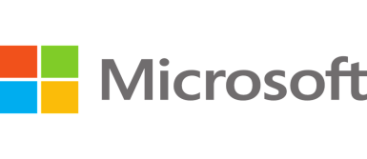
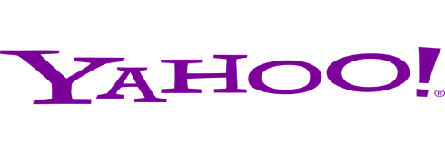
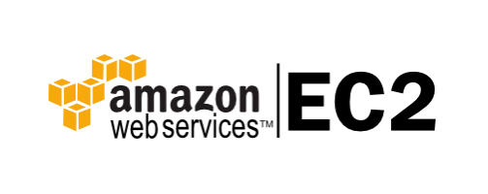

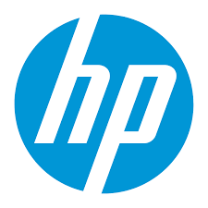
I. Massive Scale
Facebook [GigaOm, 2012]
30K in 2009 -> 60K in 2010 -> 180K in 2012
Microsoft [NYTimes, 2008]
150K machines
Growth rate of 10K per month
80K total running Bing
In 2013, Microsoft Cosmos had 110K machines (4 sites)
Yahoo! [2009]:
100K
Split into clusters of 4000
AWS EC2 [Randy Bias, 2009]
40K machines
8 cores/machine
eBay [2012]: 50K machines
HP [2012]: 380K in 180 DCs
Google: A lot
Cloud Computing and Distributed Systems
Introduction to Cloud Computing

Slide 17
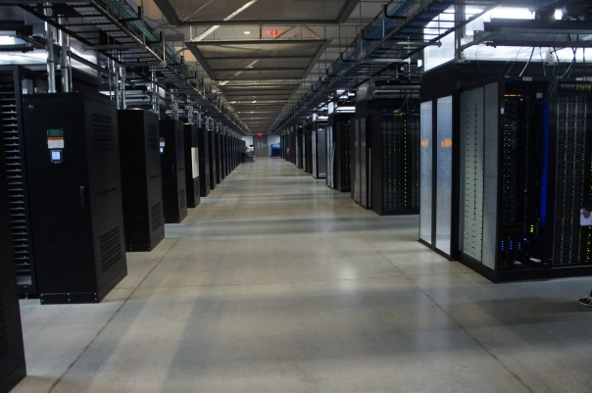
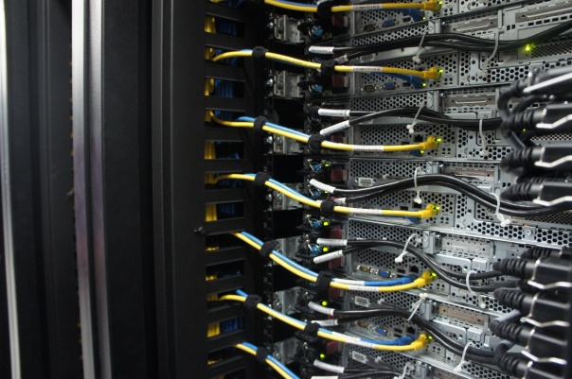
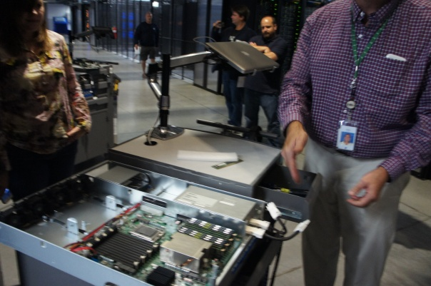
What does a datacenter look like from inside?
Lots of Servers
Cloud Computing and Distributed Systems
Introduction to Cloud Computing

Slide 18
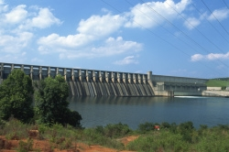
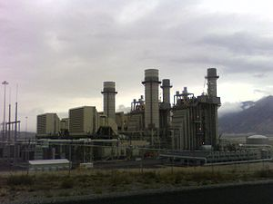
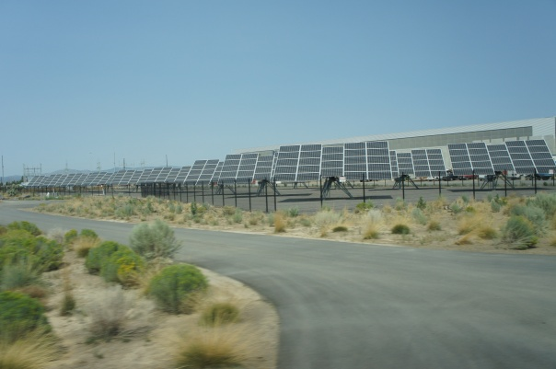
Power and Energy
WUE = Annual Water Usage / IT Equipment Energy (L/kWh)
– low is good
PUE = Total facility Power / IT Equipment Power
– low is good (e.g., Google~1.11)
Off-site
On-site
Cloud Computing and Distributed Systems
Introduction to Cloud Computing

Slide 19
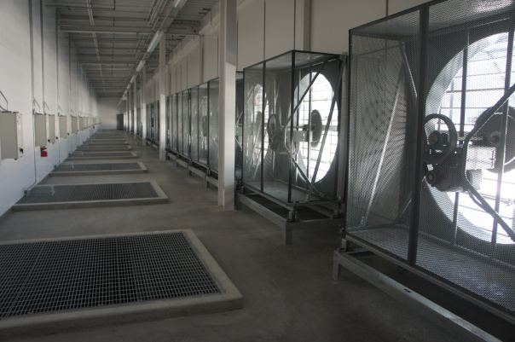
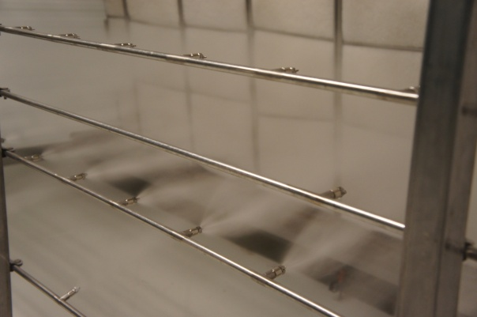
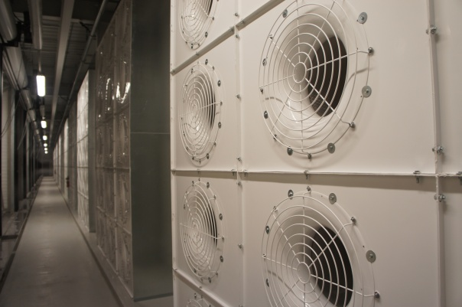
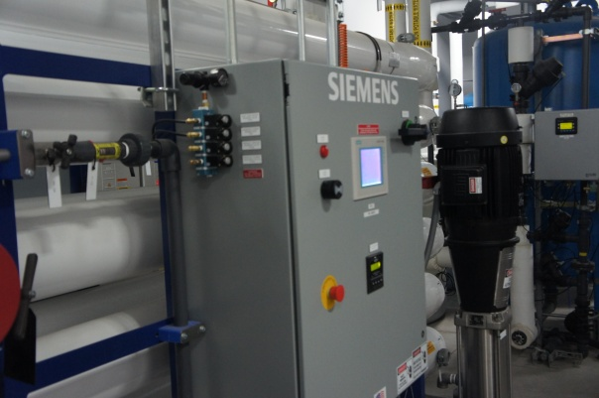
Cooling
Air sucked in
Combined with purified water
Moves cool air through system
Cloud Computing and Distributed Systems
Introduction to Cloud Computing

Slide 20
II. On-demand access: *AAS Classification
On-demand: renting vs. buying one. E.g.:
AWS Elastic Compute Cloud (EC2): a few cents to a few $ per CPU hour
AWS Simple Storage Service (S3): a few cents per GB-month
HaaS: Hardware as a Service
Get access to barebones hardware machines, do whatever you want with them, Ex: Your own cluster
Not always a good idea because of security risks
IaaS: Infrastructure as a Service
Get access to flexible computing and storage infrastructure. Virtualization is one way of achieving this. subsume HaaS.
Ex: Amazon Web Services (AWS: EC2 and S3), OpenStack, Eucalyptus, Rightscale, Microsoft Azure, Google Cloud.
Cloud Computing and Distributed Systems
Introduction to Cloud Computing

Slide 21
II. On-demand access: *AAS Classification
PaaS: Platform as a Service
Get access to flexible computing and storage infrastructure, coupled with a software platform (often tightly coupled)
Ex: Google’s AppEngine (Python, Java, Go)
SaaS: Software as a Service
Get access to software services, when you need them. subsume SOA (Service Oriented Architectures).
Ex: Google docs, MS Office on demand
Cloud Computing and Distributed Systems
Introduction to Cloud Computing

Slide 22
III. Data-intensive Computing
Computation-Intensive Computing
Example areas: MPI-based, High-performance computing, Grids
Typically run on supercomputers (e.g., NCSA Blue Waters)
Data-Intensive
Typically store data at datacenters
Use compute nodes nearby
Compute nodes run computation services
In data-intensive computing, the focus shifts from computation to the data:
CPU utilization no longer the most important resource metric, instead I/O is (disk and/or network)
Cloud Computing and Distributed Systems
Introduction to Cloud Computing

Slide 23
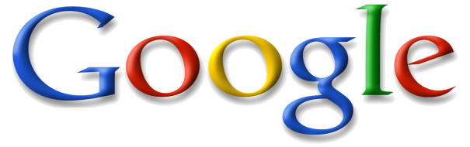
IV. New Cloud Programming Paradigms
Easy to write and run highly parallel programs in new cloud programming paradigms:
Google: MapReduce and Sawzall
Amazon: Elastic MapReduce service (pay-as-you-go)
Google (MapReduce)
Indexing: a chain of 24 MapReduce jobs
~200K jobs processing 50PB/month (in 2006)
Yahoo! (Hadoop + Pig)
WebMap: a chain of several MapReduce jobs
300 TB of data, 10K cores, many tens of hours (~2008)
Facebook (Hadoop + Hive)
~300TB total, adding 2TB/day (in 2008)
3K jobs processing 55TB/day
NoSQL: MySQL is an industry standard, but Cassandra is 2400 times faster
Cloud Computing and Distributed Systems
Introduction to Cloud Computing

Slide 24
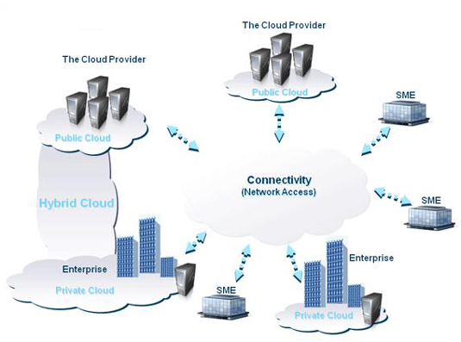
Two Categories of Clouds
Can be either a (i) public cloud, or (ii) private cloud
Private clouds are accessible only to company employees
Example of popular vendors for creating private clouds are VMware, Microsoft Azure, Eucalyptus etc.
Public clouds provide service to any paying customer
Examples of large public cloud services include Amazon EC2, Google AppEngine, Gmail, Office365 and Dropbox etc.
You’re starting a new service/company: should you use a public cloud or purchase your own private cloud?
Cloud Computing and Distributed Systems
Introduction to Cloud Computing

Slide 25
Single site Cloud: to Outsource or Own?
Medium-sized organization: wishes to run a service for M months
Service requires 128 servers (1024 cores) and 524 TB
Outsource (e.g., via AWS): monthly cost
S3 costs: $0.12 per GB month. EC2 costs: $0.10 per CPU hour (costs from 2009) Storage = $ 0.12 X 524 X 1000 ~ $62 K
Total = Storage + CPUs = $62 K + $0.10 X 1024 X 24 X 30 ~ $136 K
Own: monthly cost
Storage ~ $349 K / M Total ~ $ 1555 K / M + 7.5 K (includes 1 sysadmin / 100 nodes)
using 0.45:0.4:0.15 split for hardware:power: network and 3 year lifetime of hardware
Breakeven analysis: more preferable to own if:
^{- $349 K / M < $62 K (storage)}
⁻ $ 1555 K / M + 7.5 K < $136 K (overall)
^{Breakeven points}
^{M > 5.55 months (storage)}
^{M > 12 months (overall)}
^{-Startups use clouds a lot}
-Cloud providers benefit monetarily most from storage
Cloud Computing and Distributed Systems
Introduction to Cloud Computing

Slide 26
Conclusion
Clouds build on many previous generations of distributed systems
Characteristics of cloud computing problem
- Scale, On-demand access, data-intensive, new programming
Cloud Computing and Distributed Systems
Introduction to Cloud Computing

